Slide 1
IMDB Database
PROJECT BY
Group 3
TEJESH RATHI
PALAK AGRAWAL
SONALI CHAUDHARI

Slide 2
Contents
Introduction
ER Model
Queries
Views
PL/SQL (Procedure, Function, Trigger and Cursor)
Power of Tableau

Slide 3
Introduction
IMDB is a database of information related to Movies, TV Shows, Celebrities, News, Awards and Bookings.
Objective: Design database similar to IMDB, populate data and analyze the data

Slide 4
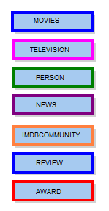
ER Model
We have created a total of 67 entities divided into 7 schemas as below:
MOVIES
PERSON
TELEVISION
AWARD
NEWS
IMDBCOMMUNITY
REVIEW

Slide 5
QUERIES
Below are the list of queries we created for our IMDB database:
Fetch Actor and Actress for each Movie which are not running in theatre currently(i.e. it is either RELEASED or it is UPCOMING’, also print Director for them AND order them by MOVIE alphabetically. (With the help of Rollup)
Query to print the total Box Office collection till date for Movie bookings at different show type for each Day and each Theatre (We used Pivot here)
Retrieve highest rated movie by Genre and if any Genre has two movies with same rating order by movie name alphabetically. (With the use of CTE)
Retrieve Top 10 Movie which has collected highest amount on BoxOffice and Print Number of weeks for which movie was running in descending order.
Highest voted poll option for every poll question (Subquery)
Number of reviews for Top 5 movies based on rating by USERS and CRITICS

Slide 6
Retrieve Budget, Box Office Collection of each Movie and decide whether it is in loss or profit.
Retrieve the number of seasons and episodes each TV Show has.
Retrieve the number of Users started particular Discussion in IMDB Community's Messageboard.
Retrieve the Number of celebrities based on their type (using Pivot).
Retrieve the cheapest ticket for each movie in each theatre for different screens.
Retrieve the details of TV shows and the time at which they come on the channel.

Slide 7
VIEWS
Fetch all the award details as per the category(movie or celebrity) awarded.
Fetch all types of news.
Different categories of shows based on range of show times.
Retrieving all the celebrities and their role in each movie.

Slide 8
PL/SQL
Combination of procedure, function and trigger.
Print celebrity details given the Celebrity name.
Add message board.
Popular movie names by Genre (based on total box office collection).
Trigger to delete all the references of poll question on deleting the poll question by the user.

Slide 9
Report of all the movies with all of its technical specifications.
Decoding the profit and loss of a movie based on it’s budget and total box office collection.

Slide 10
POWER OF TABLEAU
Tableau is data visualization software used for analysis purposes.
Tableau for IMDB Data Analysis.

Slide 11
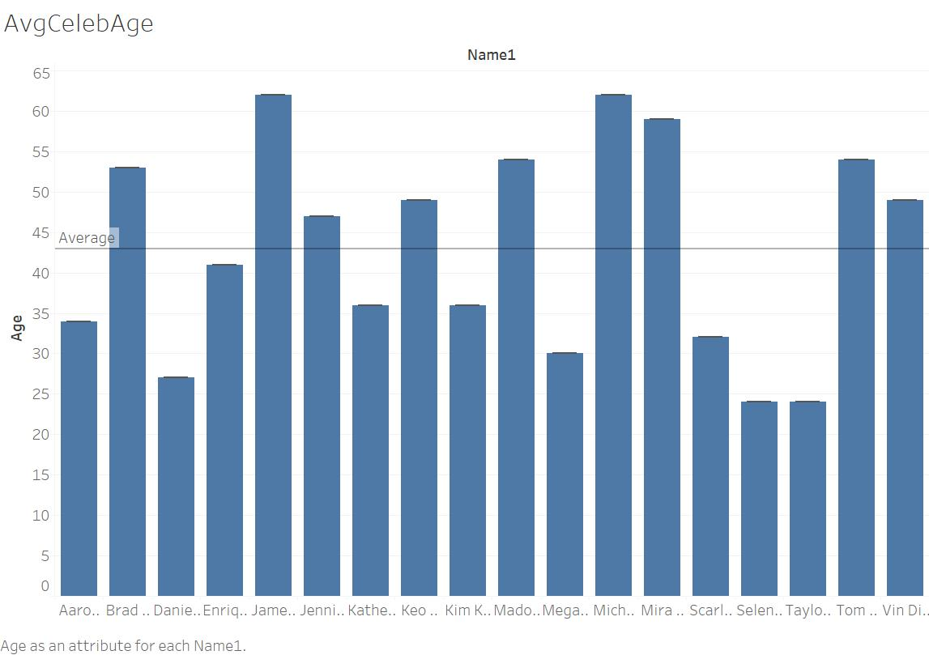
Shows the age of all the celebrities in our database and gives us the average age of Celebrities.

Slide 12
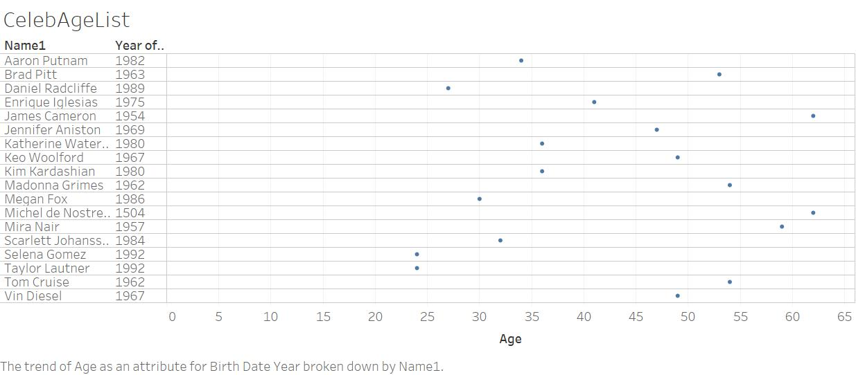
Similar to the previous one, just with additional year of their birth shown and their respective average

Slide 13
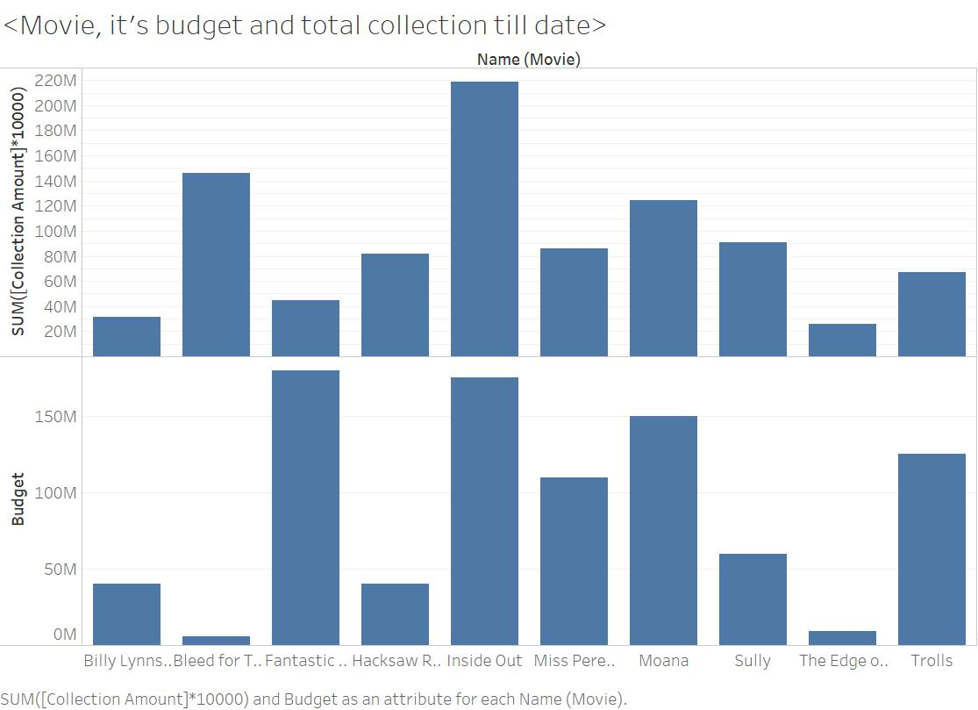
Movie name and it’s profit based on the total collection till date and the budget at which the film is made.

Slide 14
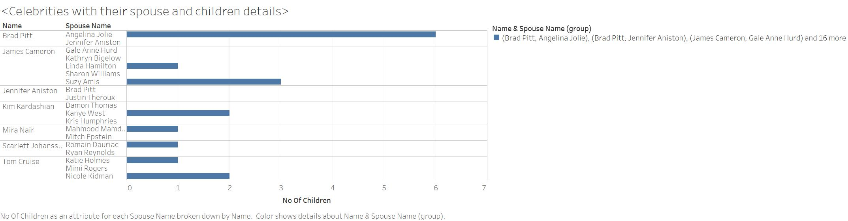
This shows us the personal details of the stars with number of spouses and children count with each, as per the IMDB.

Slide 15
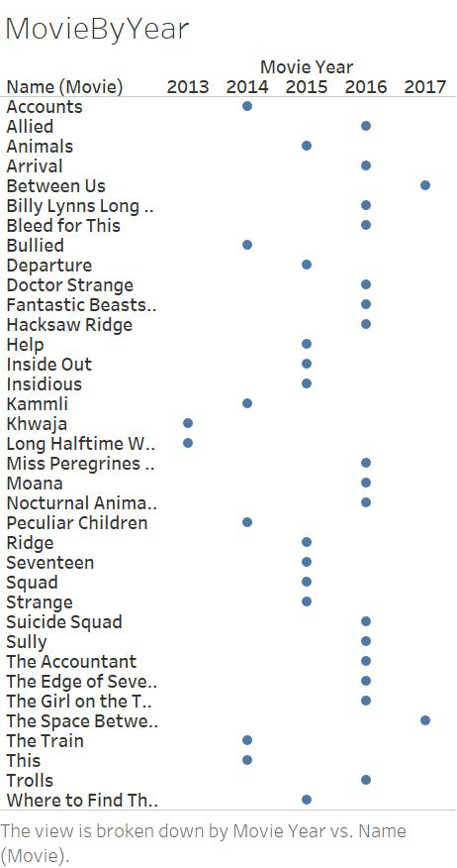
The number of movies released each year

Slide 16
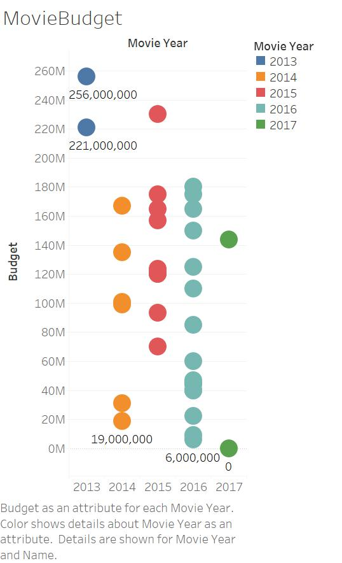
The amount of money put in on each movies with rise in the count of movies.

Slide 17
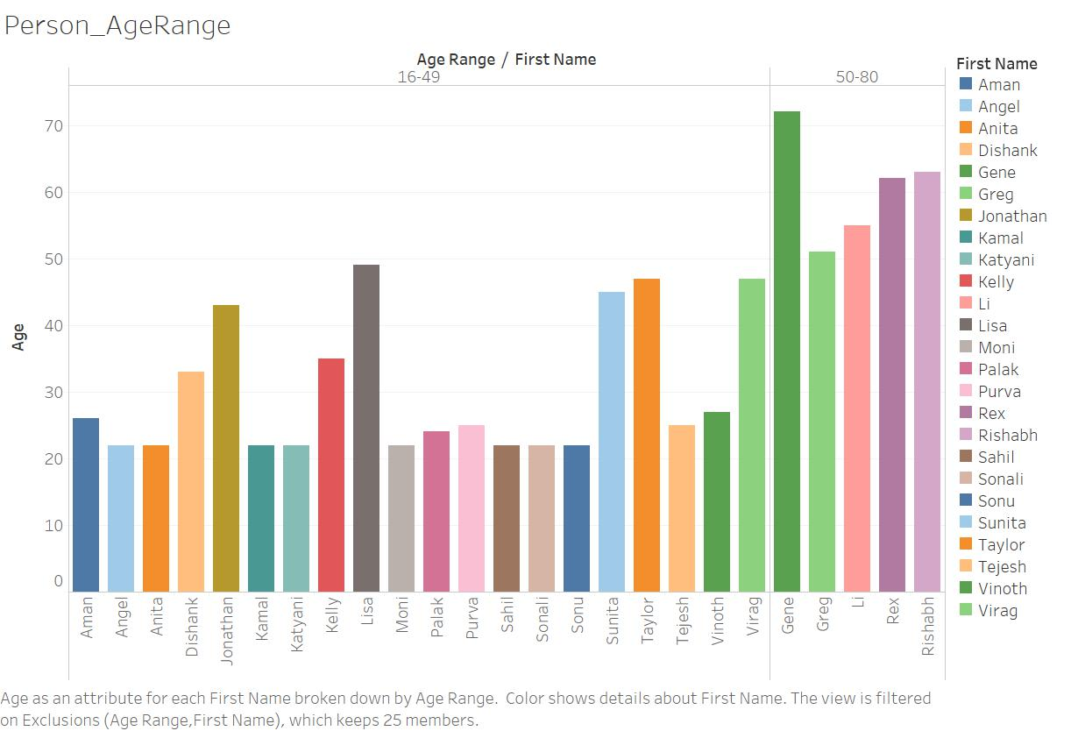
The range of users part of IMDB

Slide 18
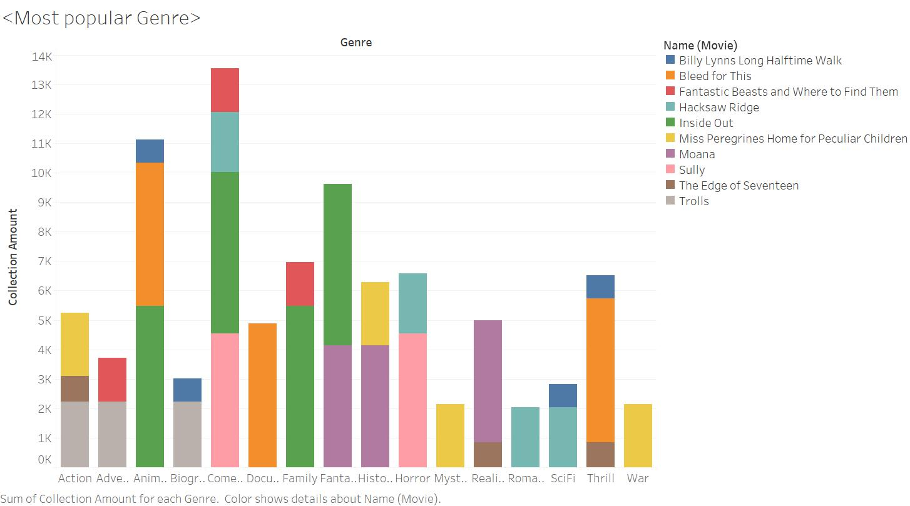
Based on one of our query which gives the most popular genre based on the box office collection

Slide 19
Questions?

